Slide 1
The Battle of the Neighborhoods -Toronto
IBM Datascience
JP Tuyikunde
June 2021

Slide 2
Problem:
Solution:
Which neighborhoods suited for restaurant/business opening?
providing recommendations to stakeholders who are interested in opening a restaurant or a business in city of Toronto

Slide 3
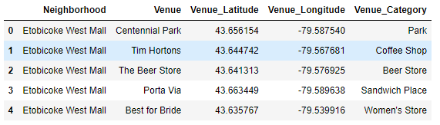
Data Acquisition
- Scraping website
- Foursquare API
Table1: snippet of dataset

Slide 4
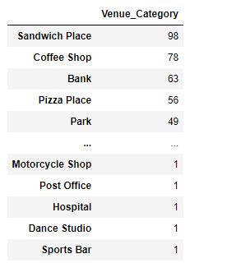
Exploratory Data Analysis
483 restaurants in dataset.
1380 other business.
Sandwich places, Coffee shops, Banks and Pizza Places are top ones.
Dance Studios and Sports Bars are the least ones.
48 unique categories in restaurants
192 unique categories in other businesses.
Top and least businesses in Neighborhoods

Slide 5
Then , how do we find the best neighborhood/location for restaurant opening or the best office area.

Slide 6
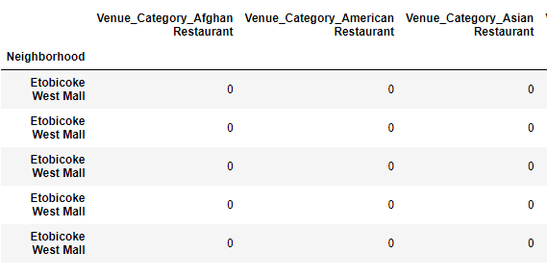
Performing One-Hot Encoding
Using pandas get_dummies() method
To perform one-hot encoding before using the categorical variables in our machine learning model.
One hot encoding on restaurants dataframe

Slide 7
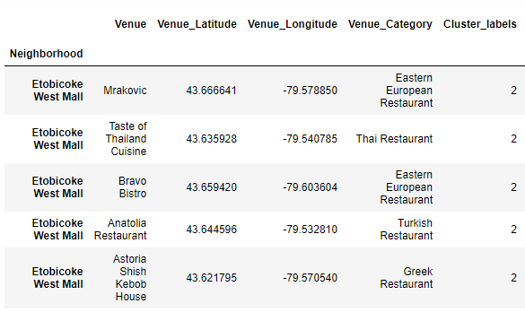
K-Means Clustering Method
To cluster restaurants in Neighborhoods.
Number of clusters : 4
Cluster-labels added to the DataFrame

Slide 8
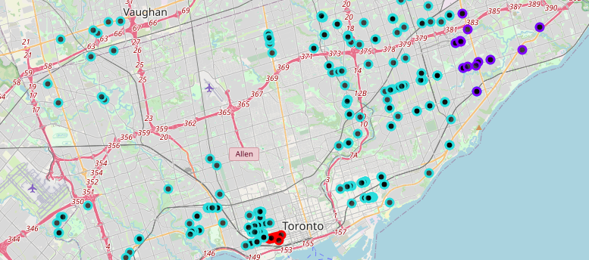
CLUSTERS ON MAP
Clusters on map

Slide 9
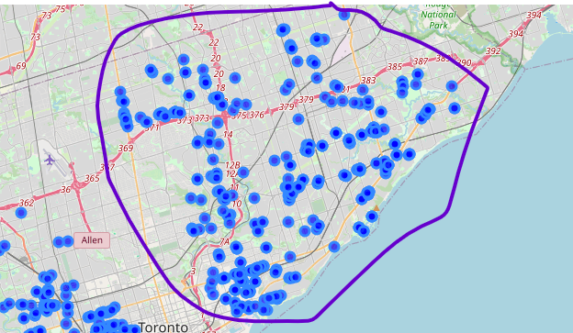
Map of other Business
High-density business area

Slide 10
In Summary
In Cluster 1 there is large number of American Restaurants but again their number keep getting low in the other Clusters.
Major competition in opening the Fast food type of restaurants.
Opening Indian and Italian restaurants in Cluster1, is worth it since there is less competition.
Opening an office on North-East of University of Toronto is recommended, due to availability of other business like cafes, brewery, bars and banks.

Slide 11
Further Exploration
What is the rating and attractiveness of nearby restaurants?
What are ups and downs of the each neighborhoods?
What is the impact of nearby communities in making the businesses successful?

Slide 12
Thank You.

